Slide 1
Databricks
An overview of Databricks and its features.

Slide 2
What is Databricks?
Databricks is a unified analytics platform.
Databricks provides a collaborative environment for data scientists, data engineers, and business analysts.
It is built for massive scale and high-performance analytics.
It supports various programming languages like Python, Scala, and R.

Slide 3
Key Features
Advanced analytics capabilities.
Scalable and elastic cloud infrastructure.
Built-in collaboration tools for teams.
Real-time data processing.
Integration with popular data sources.

Slide 4
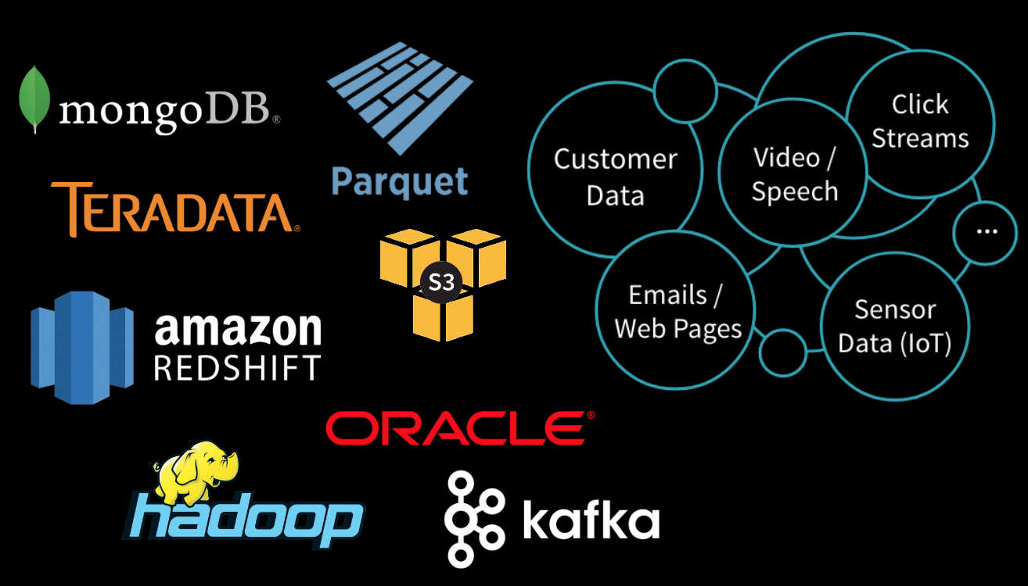
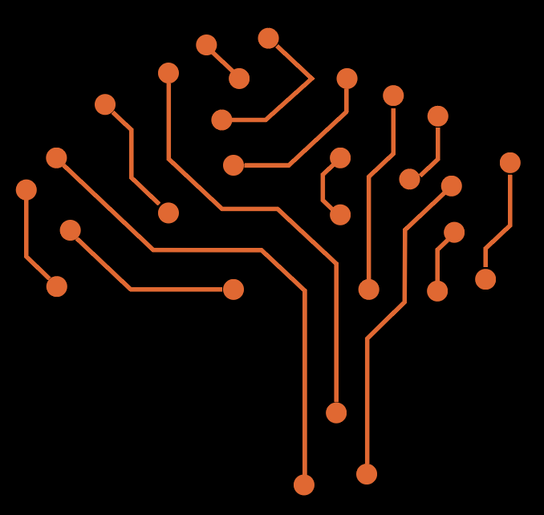

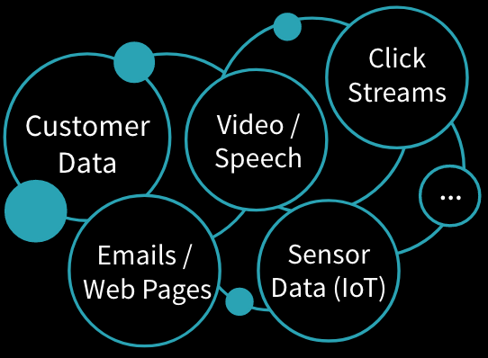



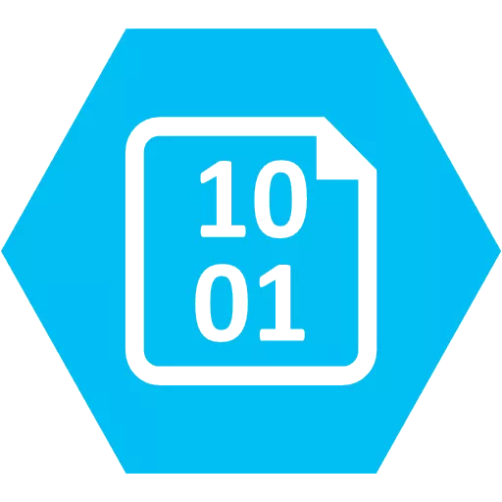

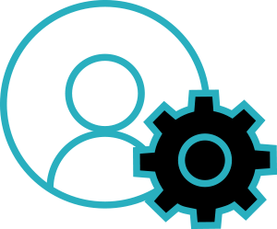
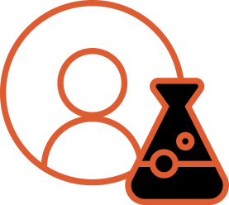
Data & AI People are in Silos
x
DATA ENGINEERS
DATA SCIENTISTS
Notes:
Data is in different places -- EXAMPLE Hadoop is great for DATA, not AI
EXAMPLE Tensorflow is great for AI, but can’t do processing
EXAMPLE Petabytes of logs streaming from devices to AI is NON TRIVIAL.

Slide 5

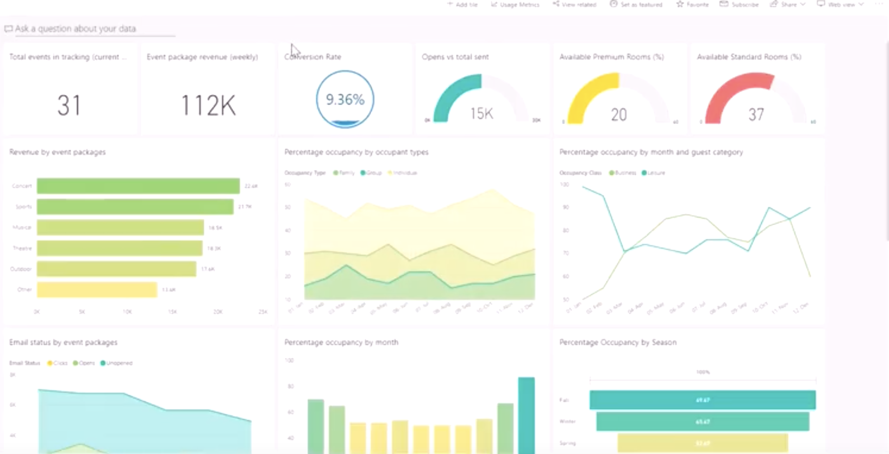










AZURE
DATA SOURCES
DATABRICKS COLLABORATIVE WORKSPACE
Notebooks
Blob Storage
Jobs
Models
Apis
Dashboards
Data Lake Store
DATA ENGINEERS DATA SCIENTISTS
SQL Data Warehouse
DATABRICKS RUNTIME
BI Reporting
Dashboards
Cosmos DB
for Big Data
for Machine Learning
Event Hub
Batch & Streaming
Data Lakes & Data Warehouses
IoT Hub
DATABRICKS CLOUD SERVICE
Security Integration
Azure Data Factory
Azure Portal
One-Click setup
Unified Billing
Notes:
We address these challenges with our Unified Analytics Platform. We provide a Cloud native service that is built on Azure and AWS eliminating significant infrastructure complexity. With Databricks Delta, we have extended Apache Spark to simplify data engineering by providing high performance at scale, and data reliability through transactional integrity. We have also packaged up all the popular ML frameworks into our Runtime to truly simplify model training and model deployment. By integrating Delta and the ML frameworks we have unified data and AI technologies under one umbrella to simplify the entire ML lifecycle.
Our Collaborative workspace includes the ability to run, manage jobs, leverage APIs for integrating into data engineering toolsets for data engineers; notebooks and dashboards for data scientists to explore data, build models and share work with other stakeholders. Have one common collaborative workspace for data engineers and data scientists enables the entire team to be more 10x more productive.

Slide 6



What is Azure Databricks?
A fast, easy and collaborative Apache® Spark™ based analytics platform optimized for Azure
Best of Databricks
Best of Microsoft
Designed in collaboration with the founders of Apache Spark
One-click set up; streamlined workflows
Interactive workspace that enables collaboration between data scientists, data engineers, and business analysts.
Native integration with Azure services (Power BI, SQL DW, Cosmos DB, Blob Storage)
Enterprise-grade Azure security (Active Directory integration, compliance, enterprise-grade SLAs)
Notes:
Azure Databricks features –
Enhance your teams’ productivity
Get started quickly by launching your new Spark environment with one click.
Share your insights in powerful ways through rich integration with PowerBI.
Improve collaboration amongst your analytics team through a unified workspace.
Innovate faster with native integration with rest of Azure platform.
Build on the most compliant and trusted cloud
Simplify security and identity control with built-in integration with Active Directory.
Regulate access with fine-grained user permissions to Azure Databricks’ notebooks, clusters, jobs and data.
Build with confidence on the trusted cloud backed by unmatched support, compliance and SLAs.
Scale without limits
Operate at massive scale without limits globally.
Accelerate data processing with the fastest Spark engine.

Slide 7
What is Azure Databricks?
Azure Databricks is a unified, open analytics platform for building, deploying, sharing, and maintaining enterprise-grade data, analytics, and AI solutions at scale. The Databricks Data Intelligence Platform integrates with cloud storage and security in your cloud account, and manages and deploys cloud infrastructure on your behalf.
The Azure Databricks workspace provides a unified interface and tools for most data tasks, including:
Data processing workflows scheduling and management
Generating dashboards and visualizations
Managing security, governance, high availability, and disaster recovery
Data discovery, annotation, and exploration
Machine learning (ML) modeling, tracking, and model serving
Generative AI solutions
Notes:
https://learn.microsoft.com/en-us/azure/databricks/introduction/

Slide 8
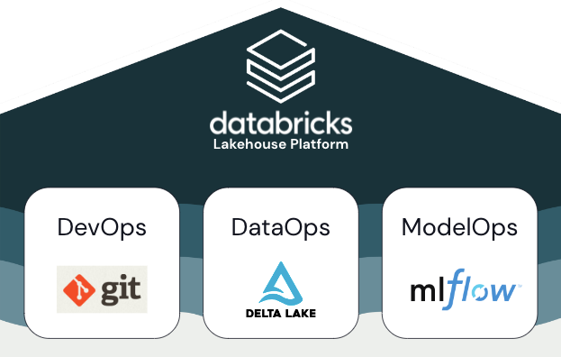
Azure Databricks MLOPS

Slide 9
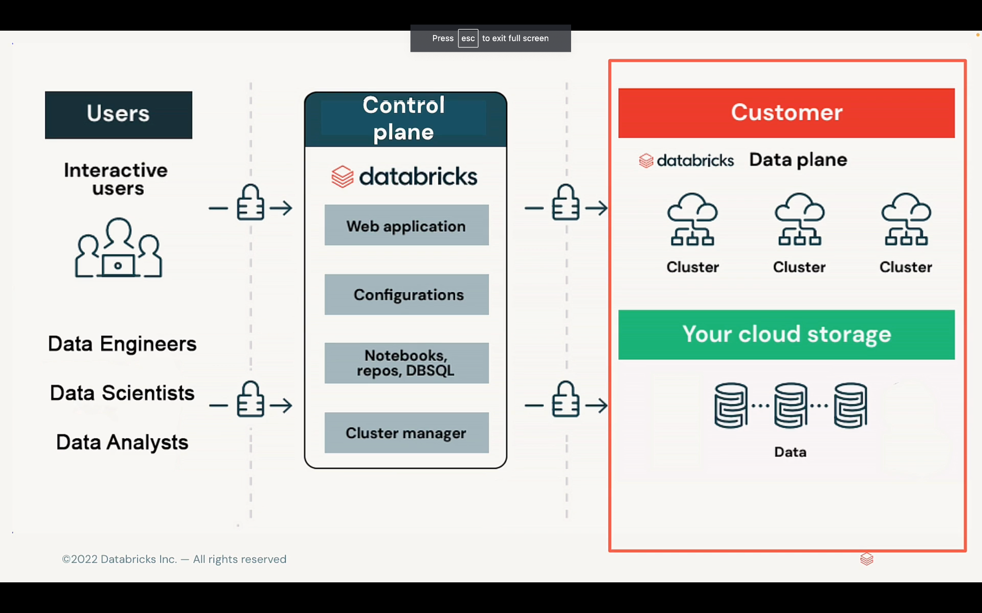

Slide 10
What is Delta lake?

Slide 11
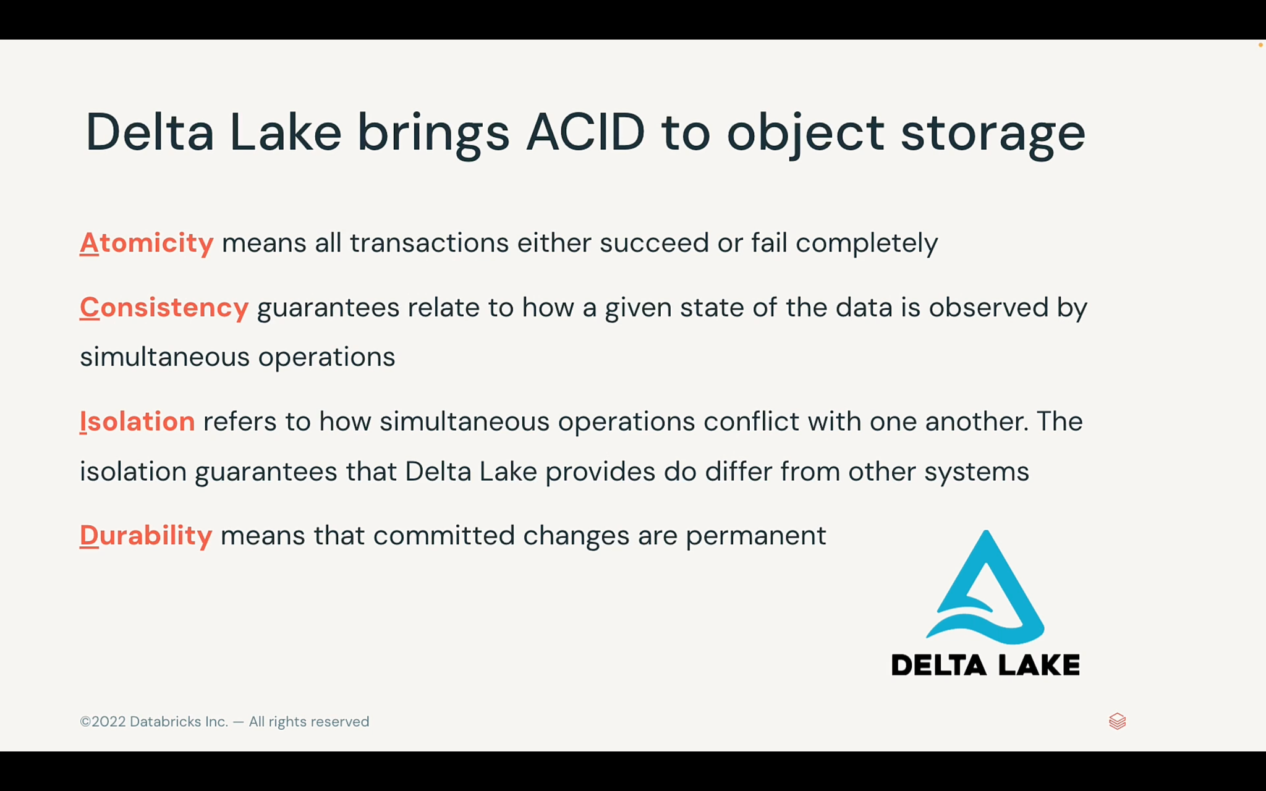

Slide 12
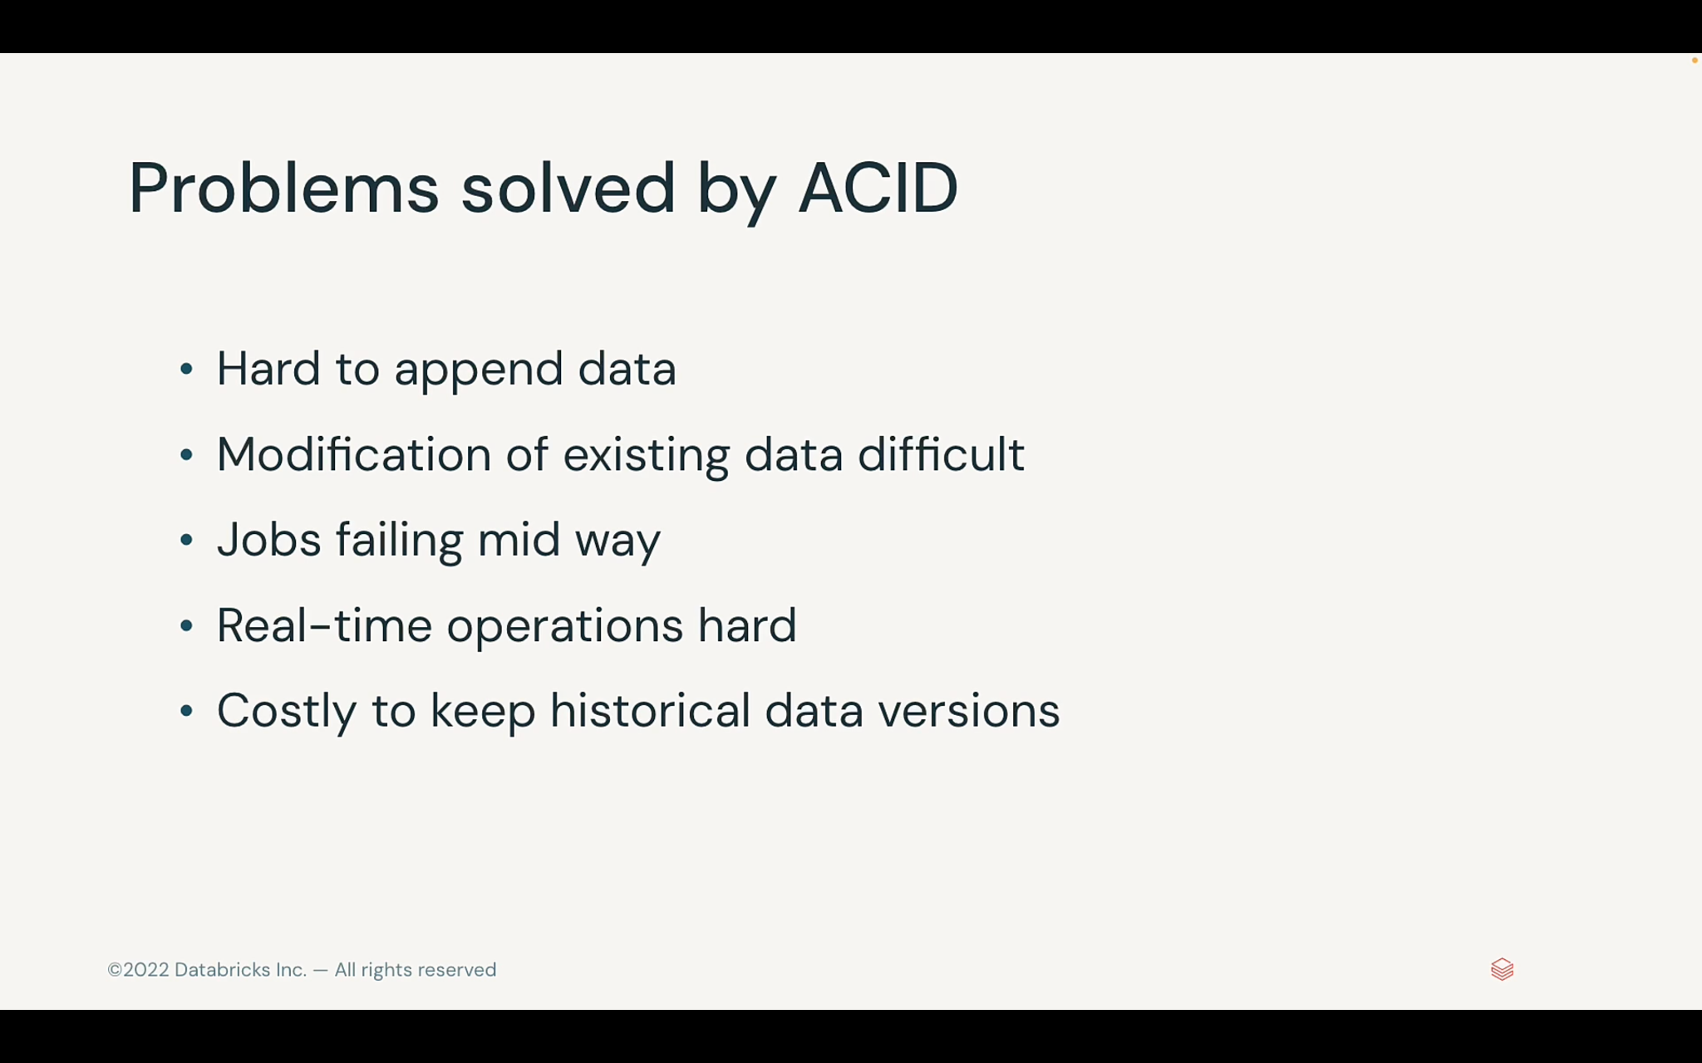

Slide 13
What is Unity Catalog?

Slide 14
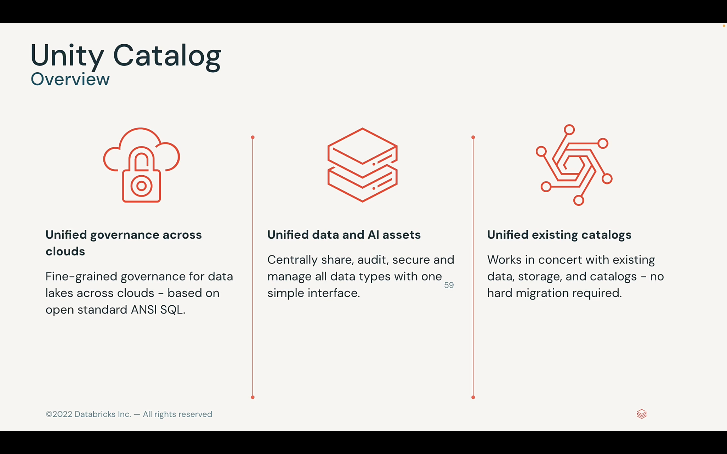

Slide 15
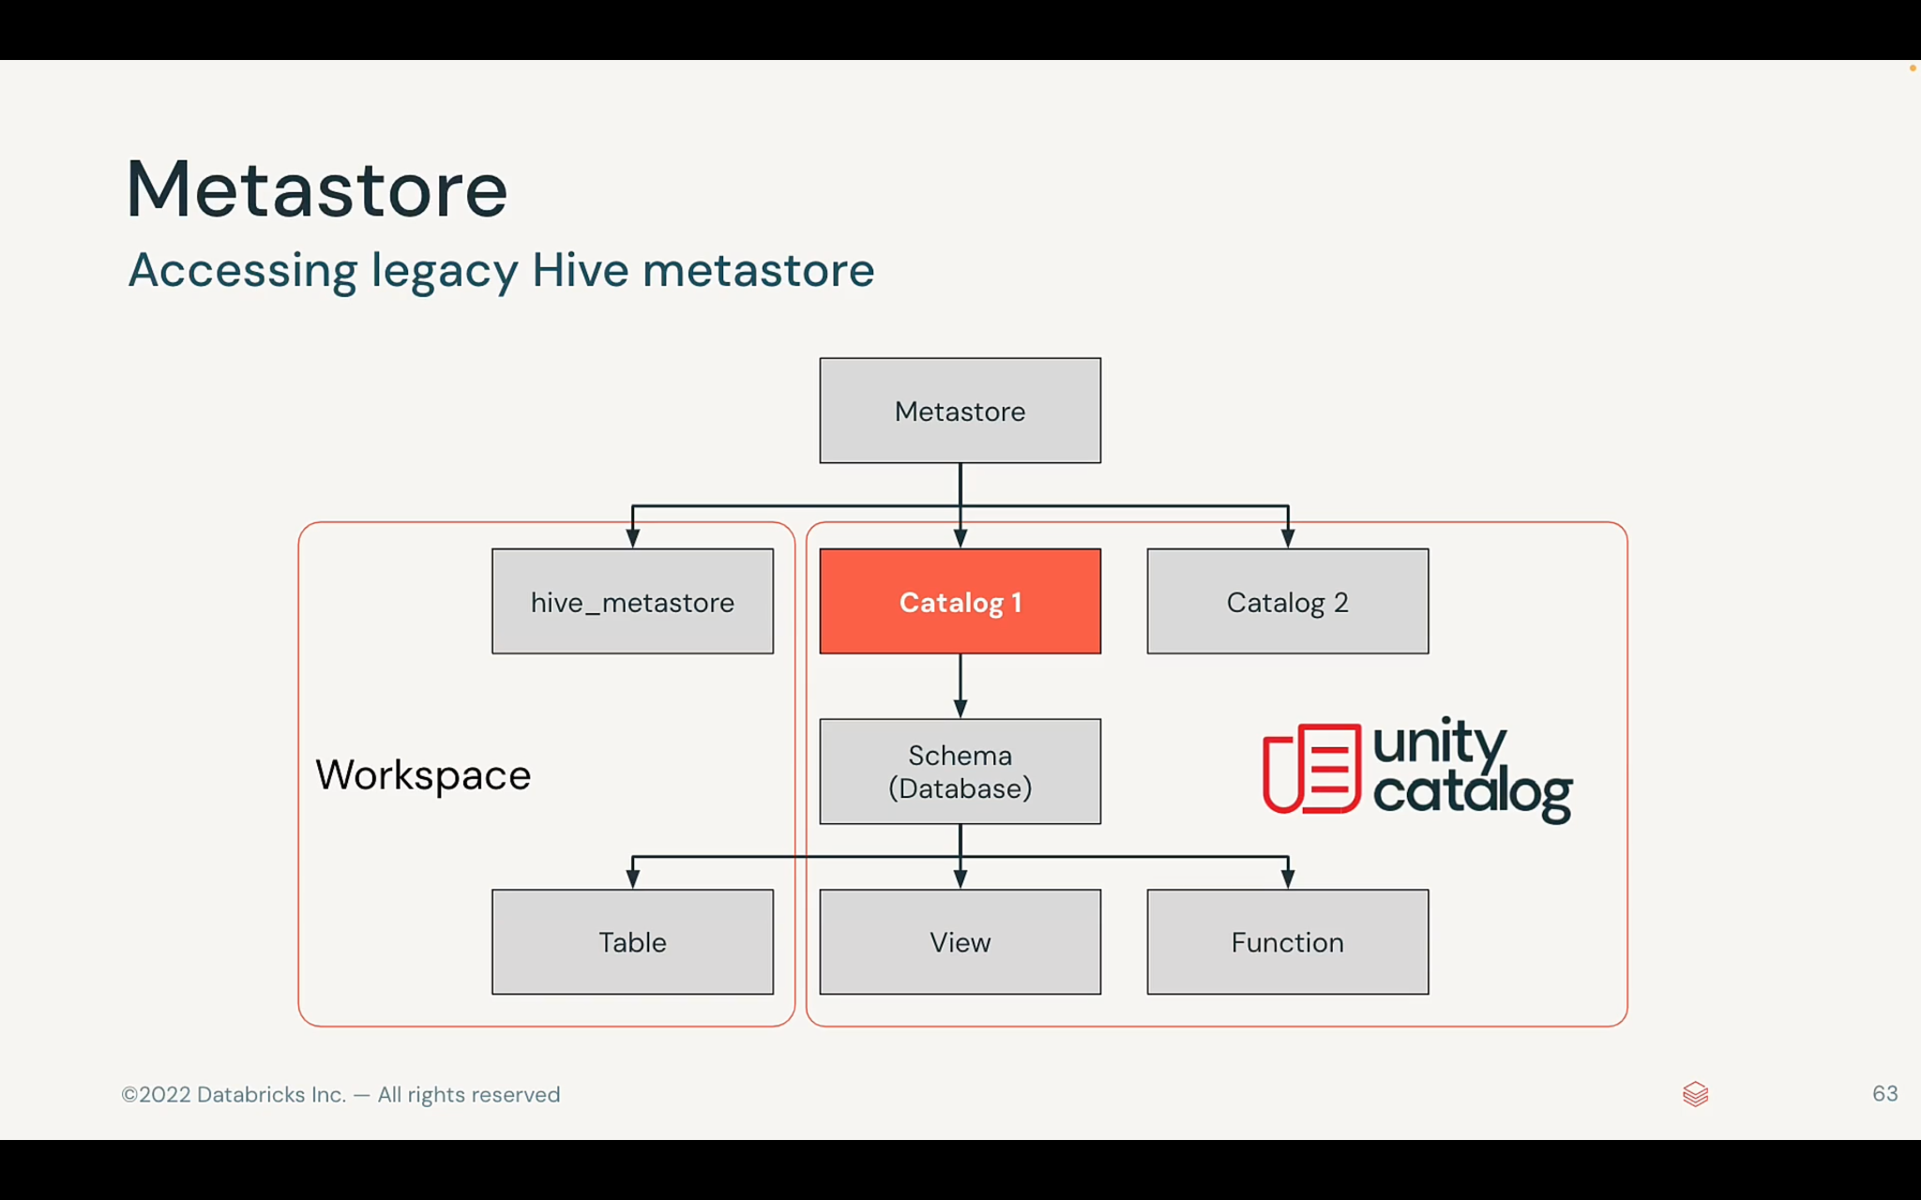

Slide 16
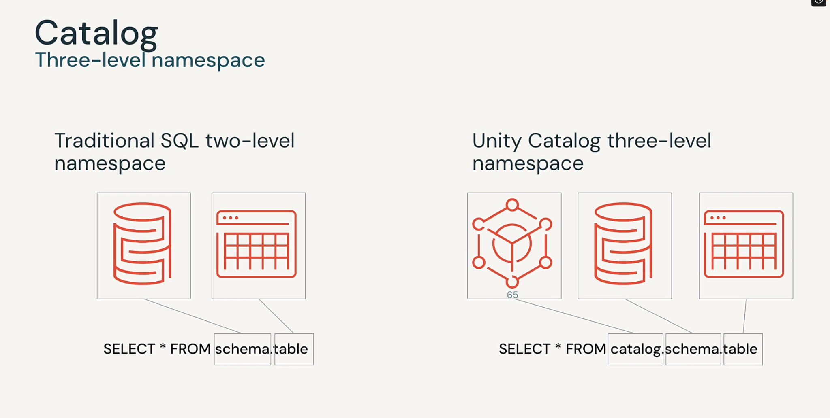

Slide 17
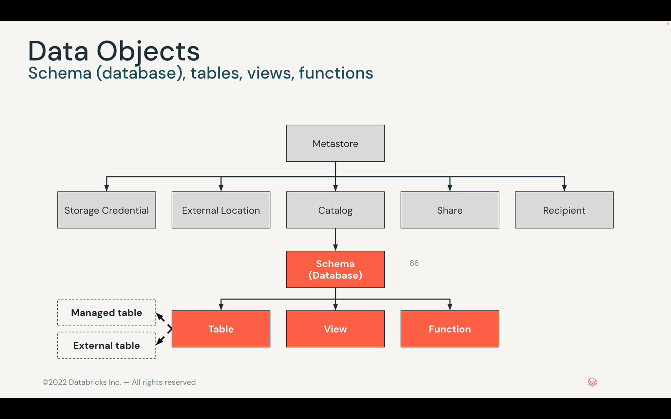

Slide 18
What is Workflow?

Slide 19
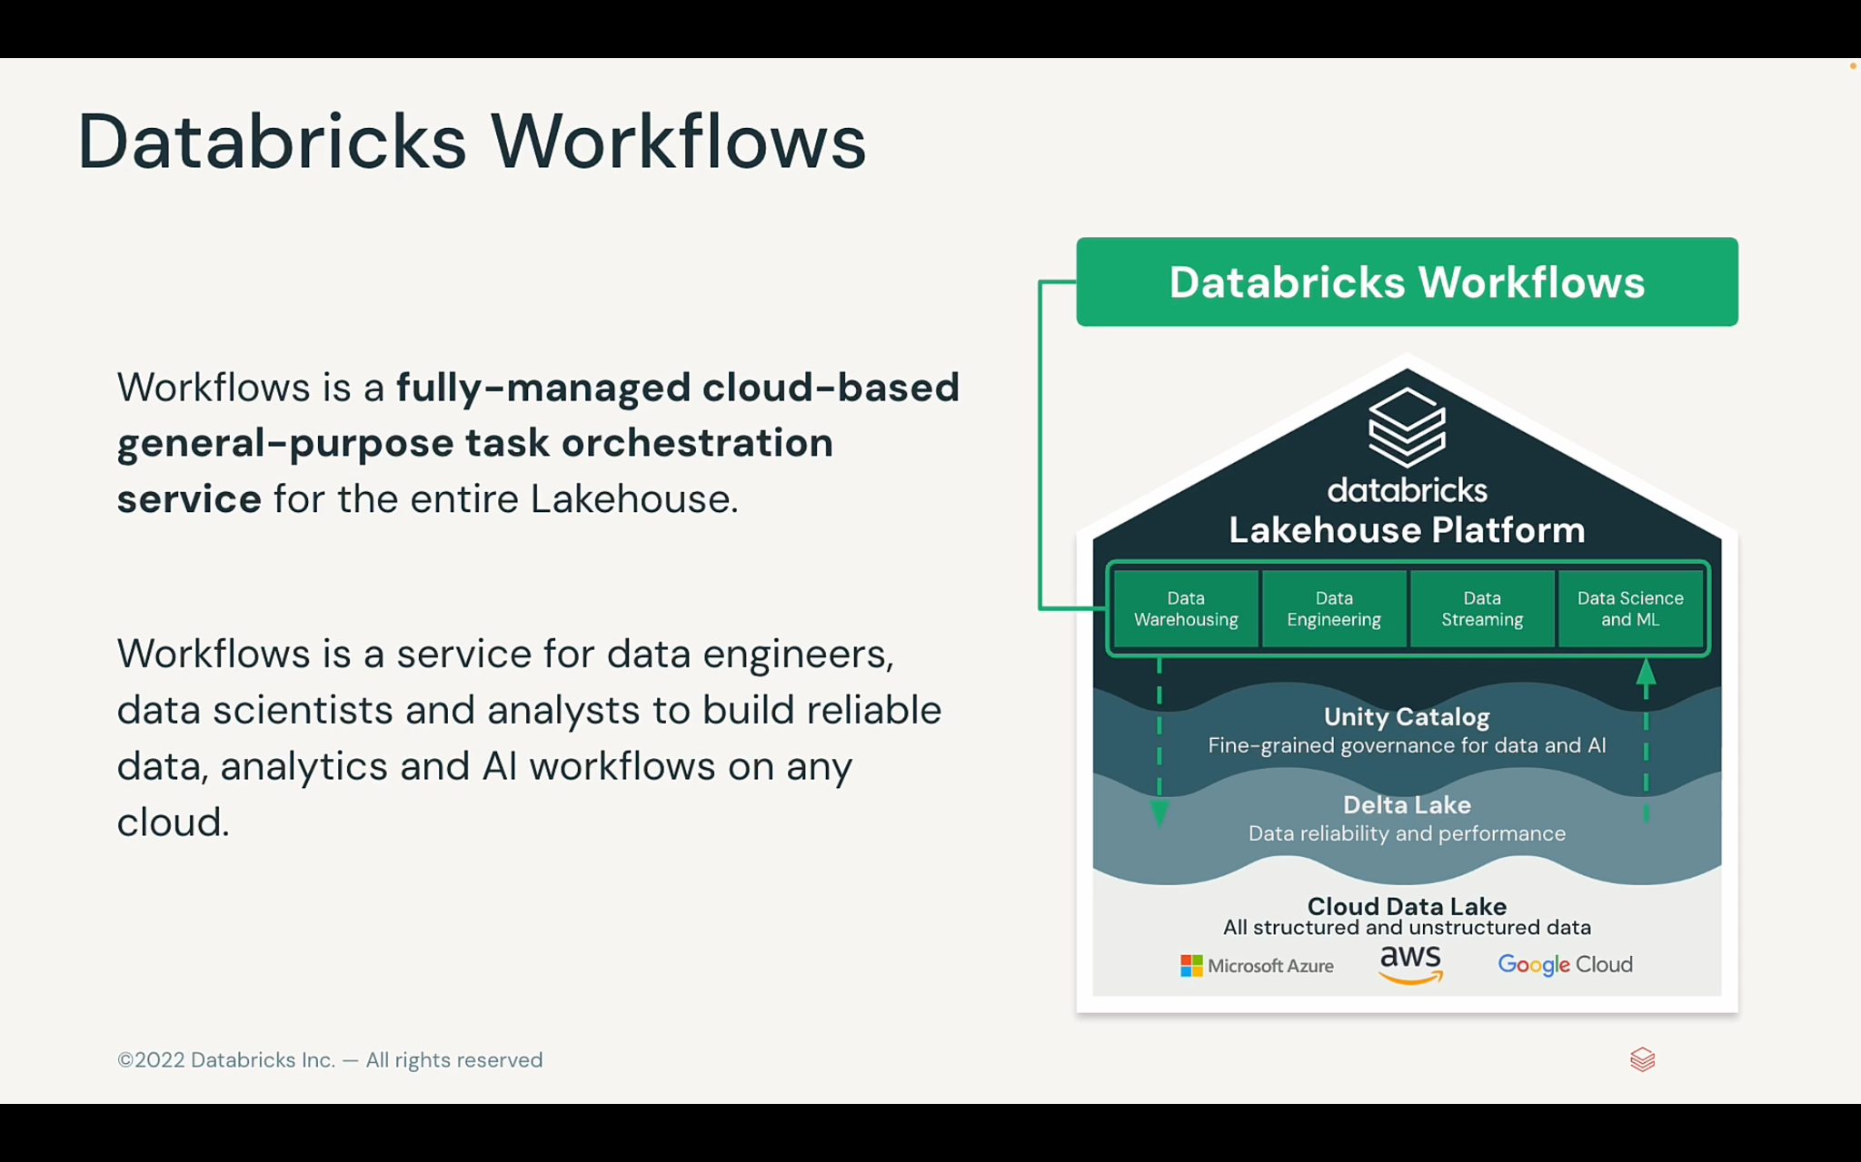

Slide 20
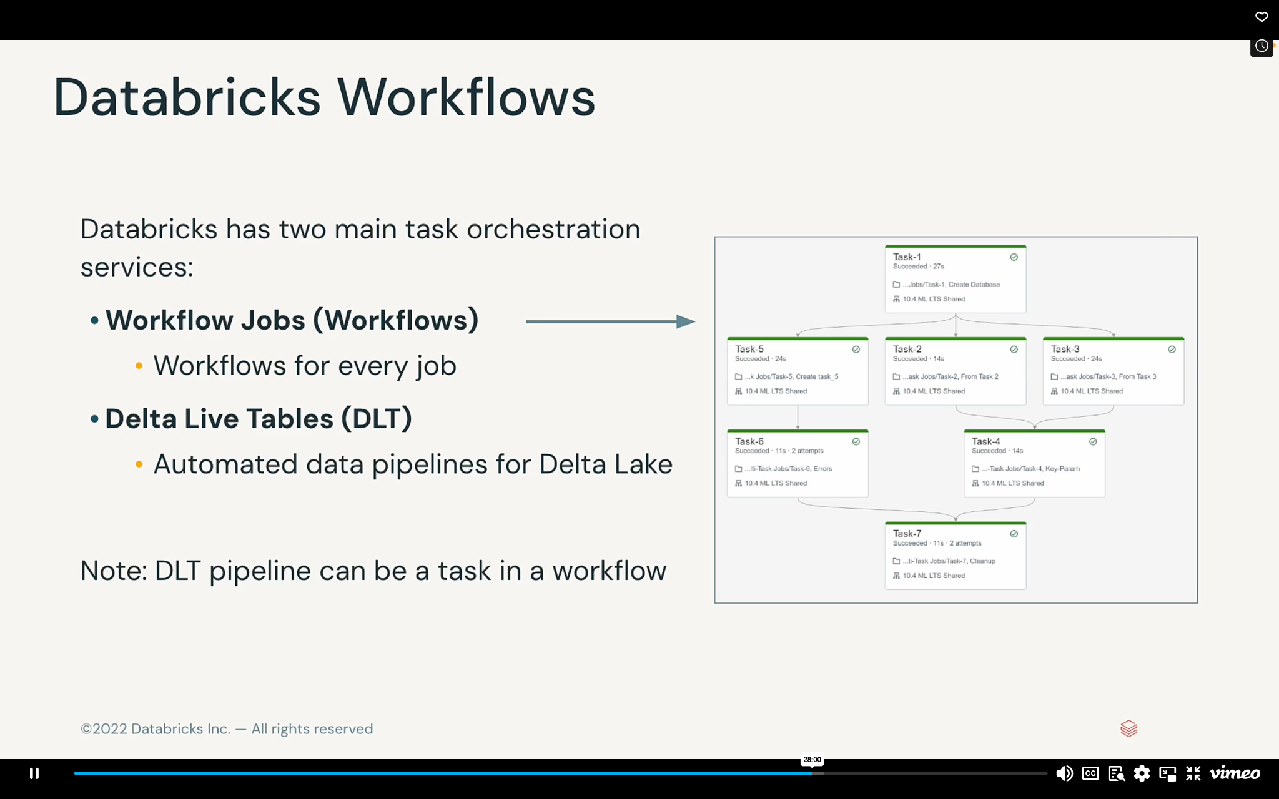

Slide 21
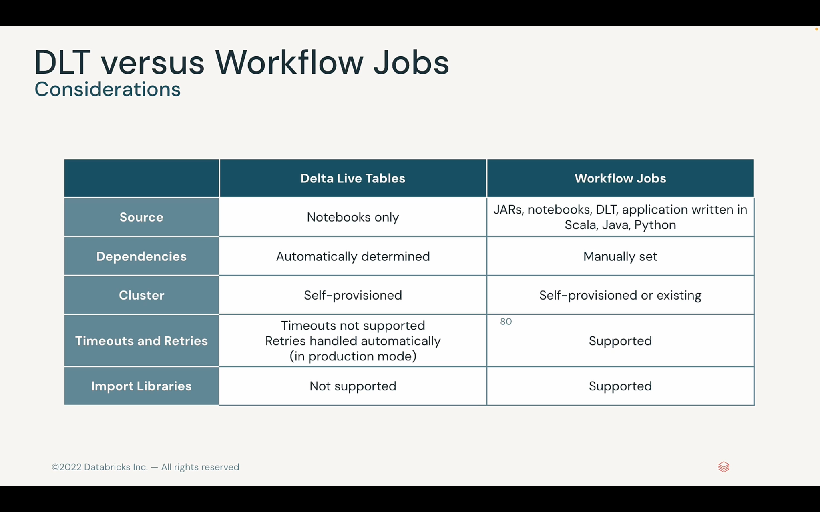

Slide 22
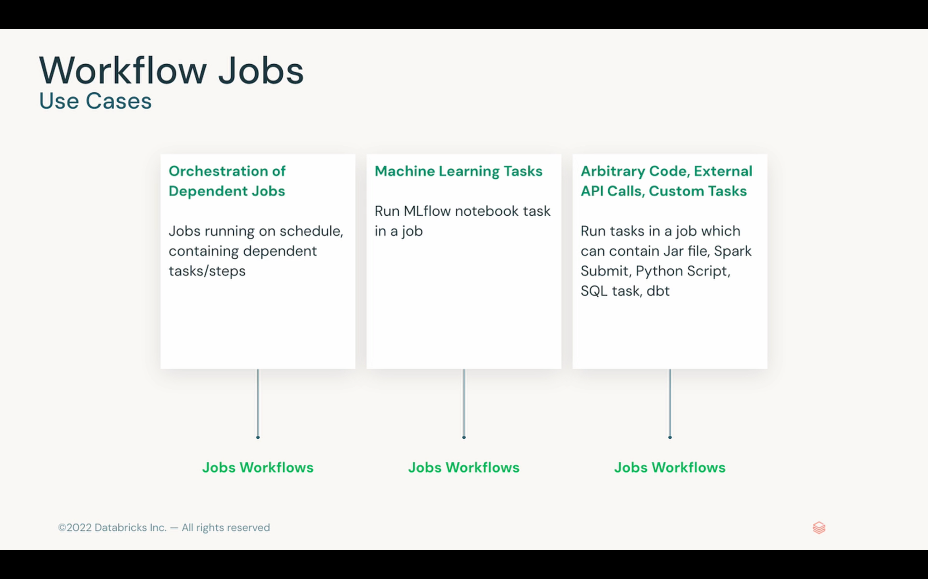

Slide 23
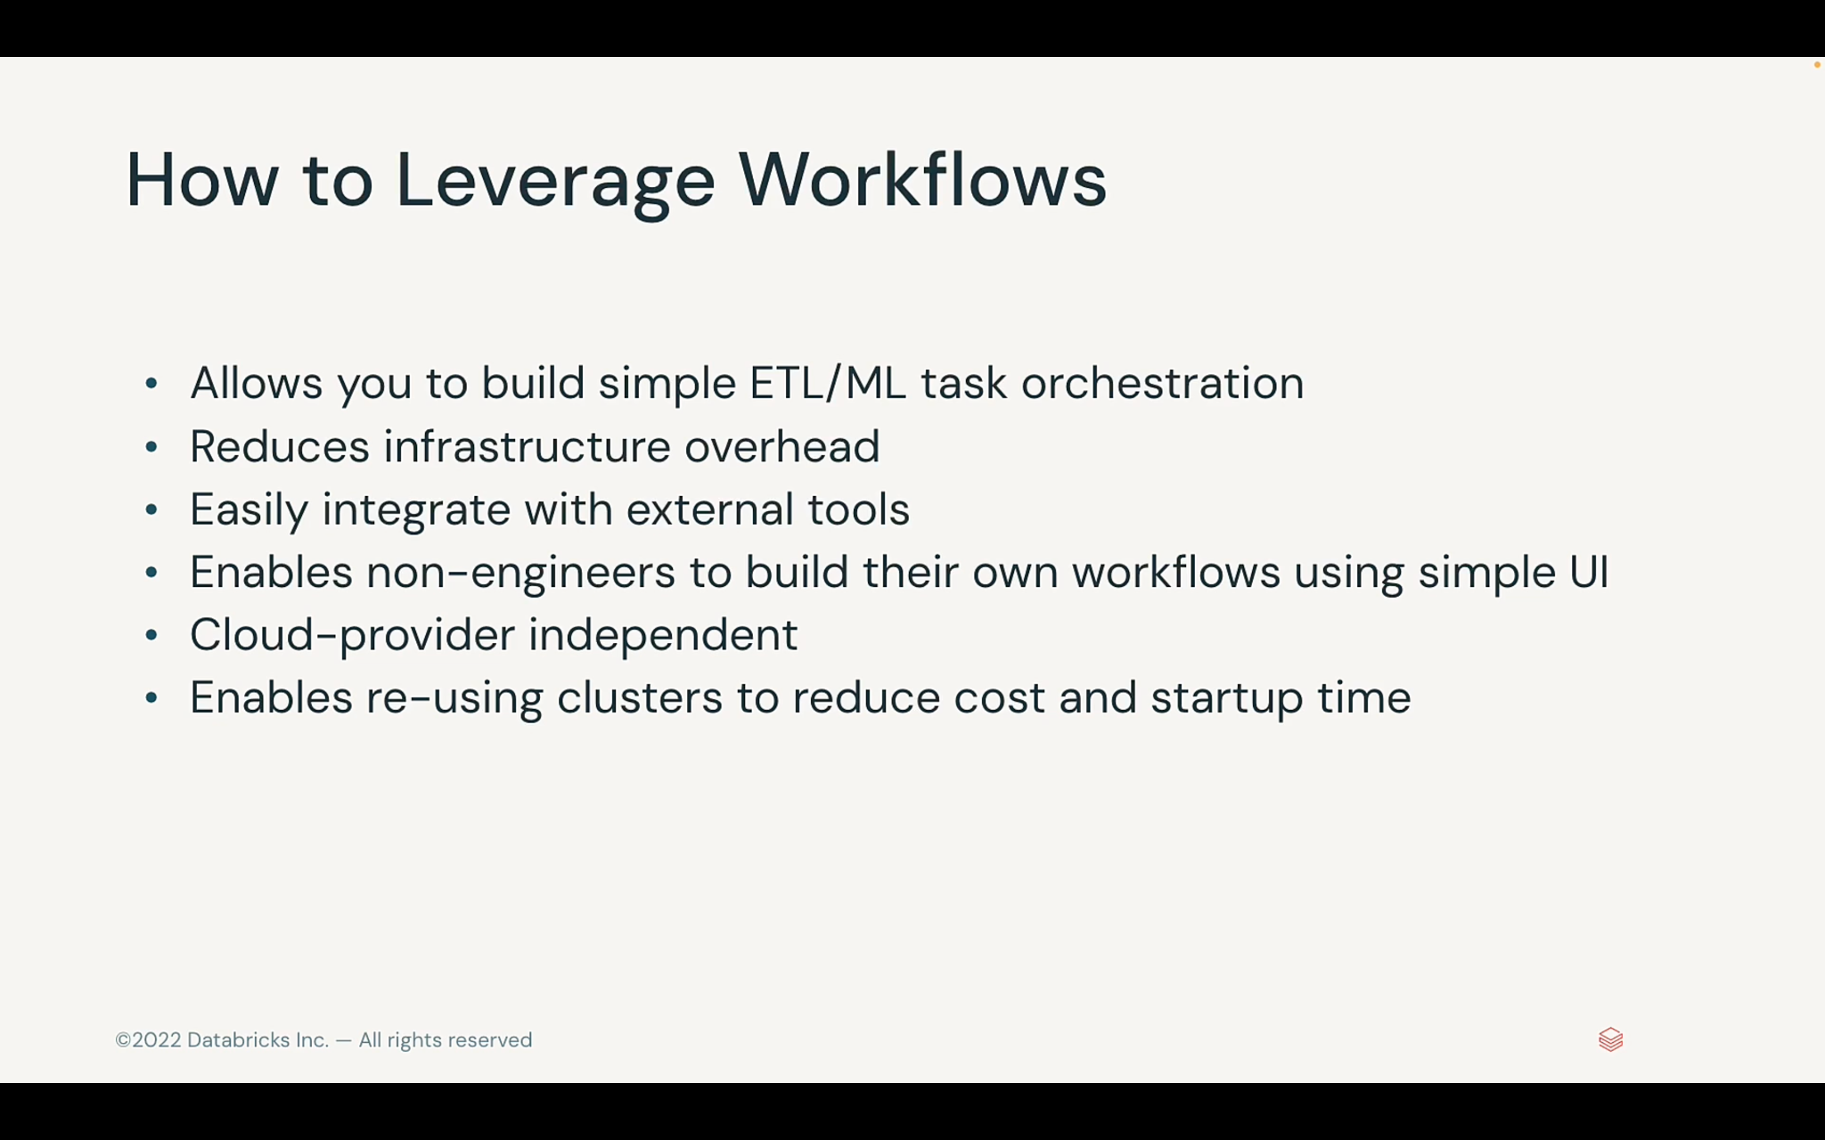

Slide 24
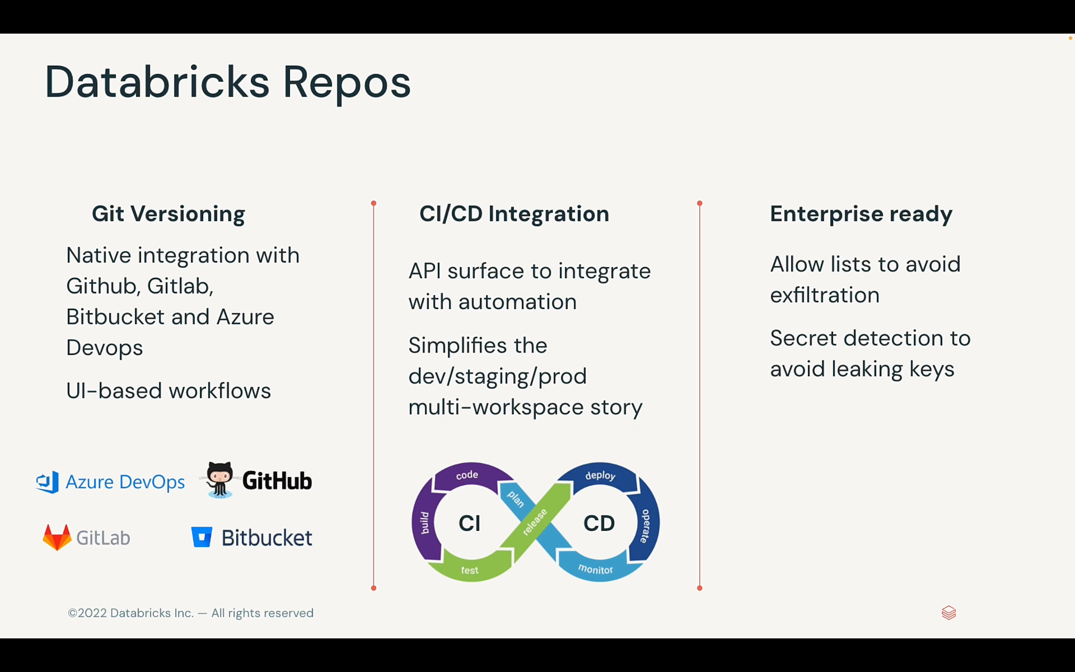

Slide 25
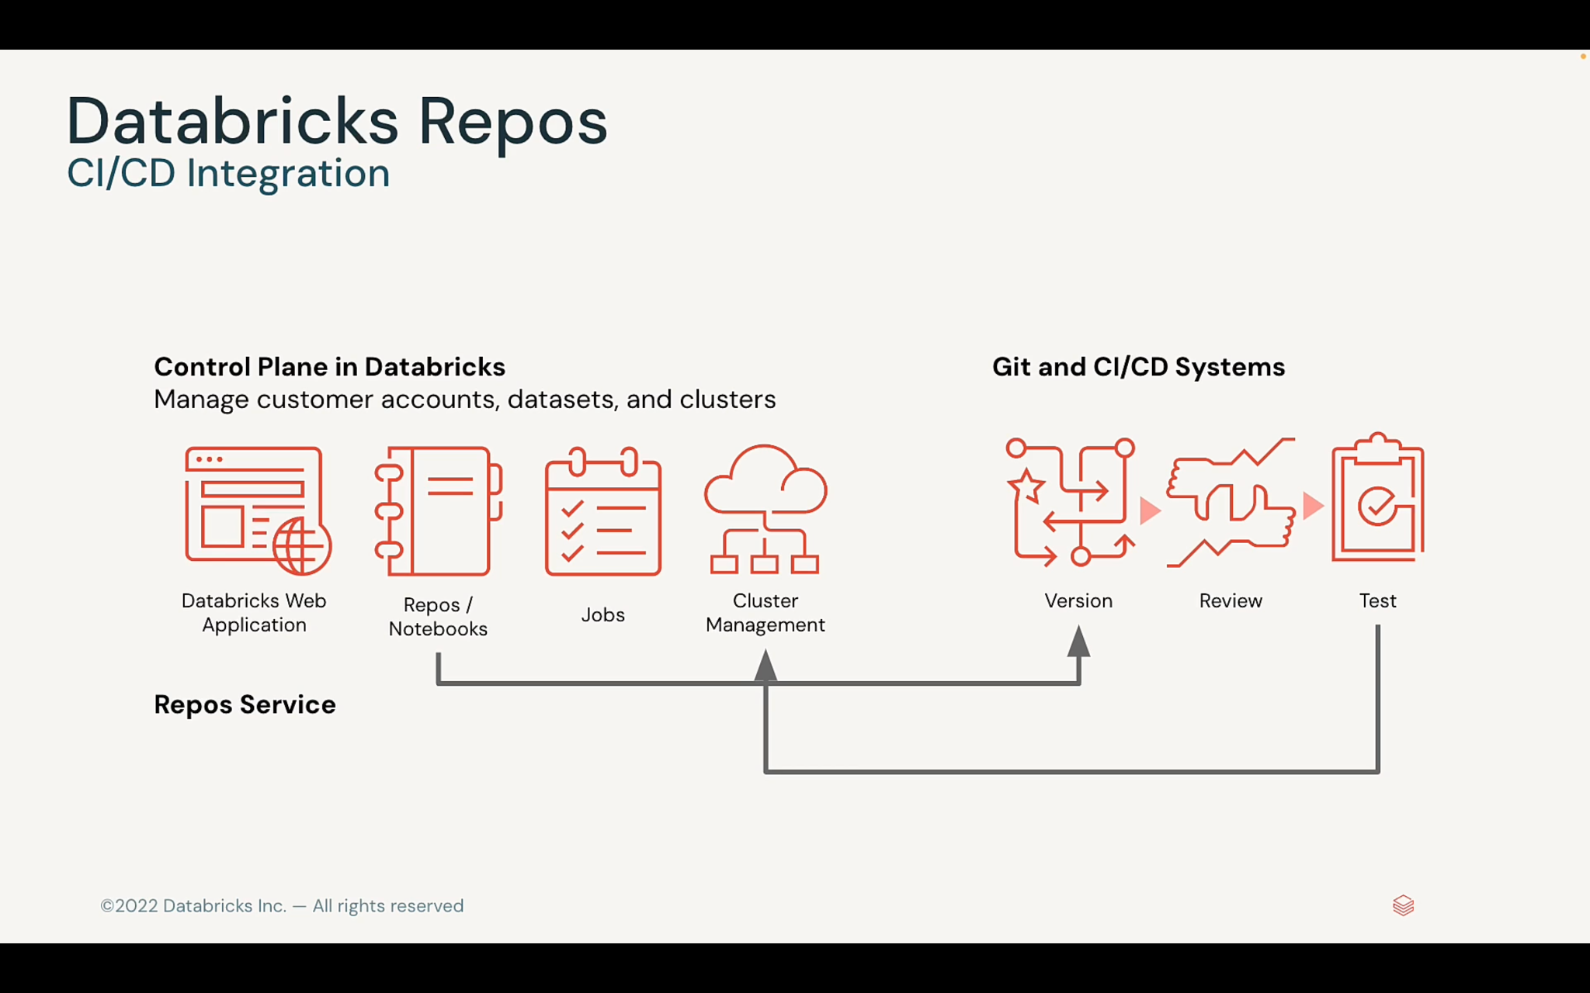

Slide 26

Demo

Slide 27
What is Cluster?

Slide 28
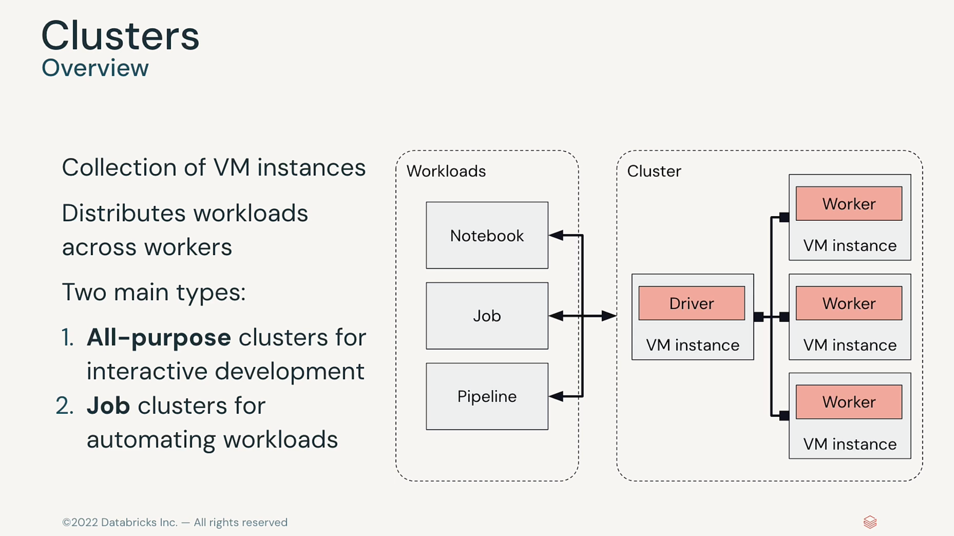

Slide 29
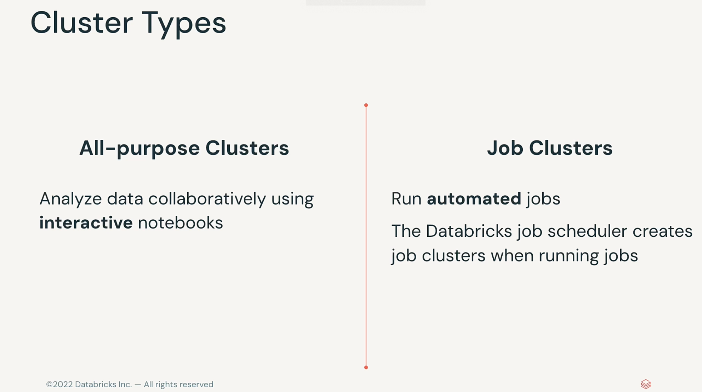

Slide 30
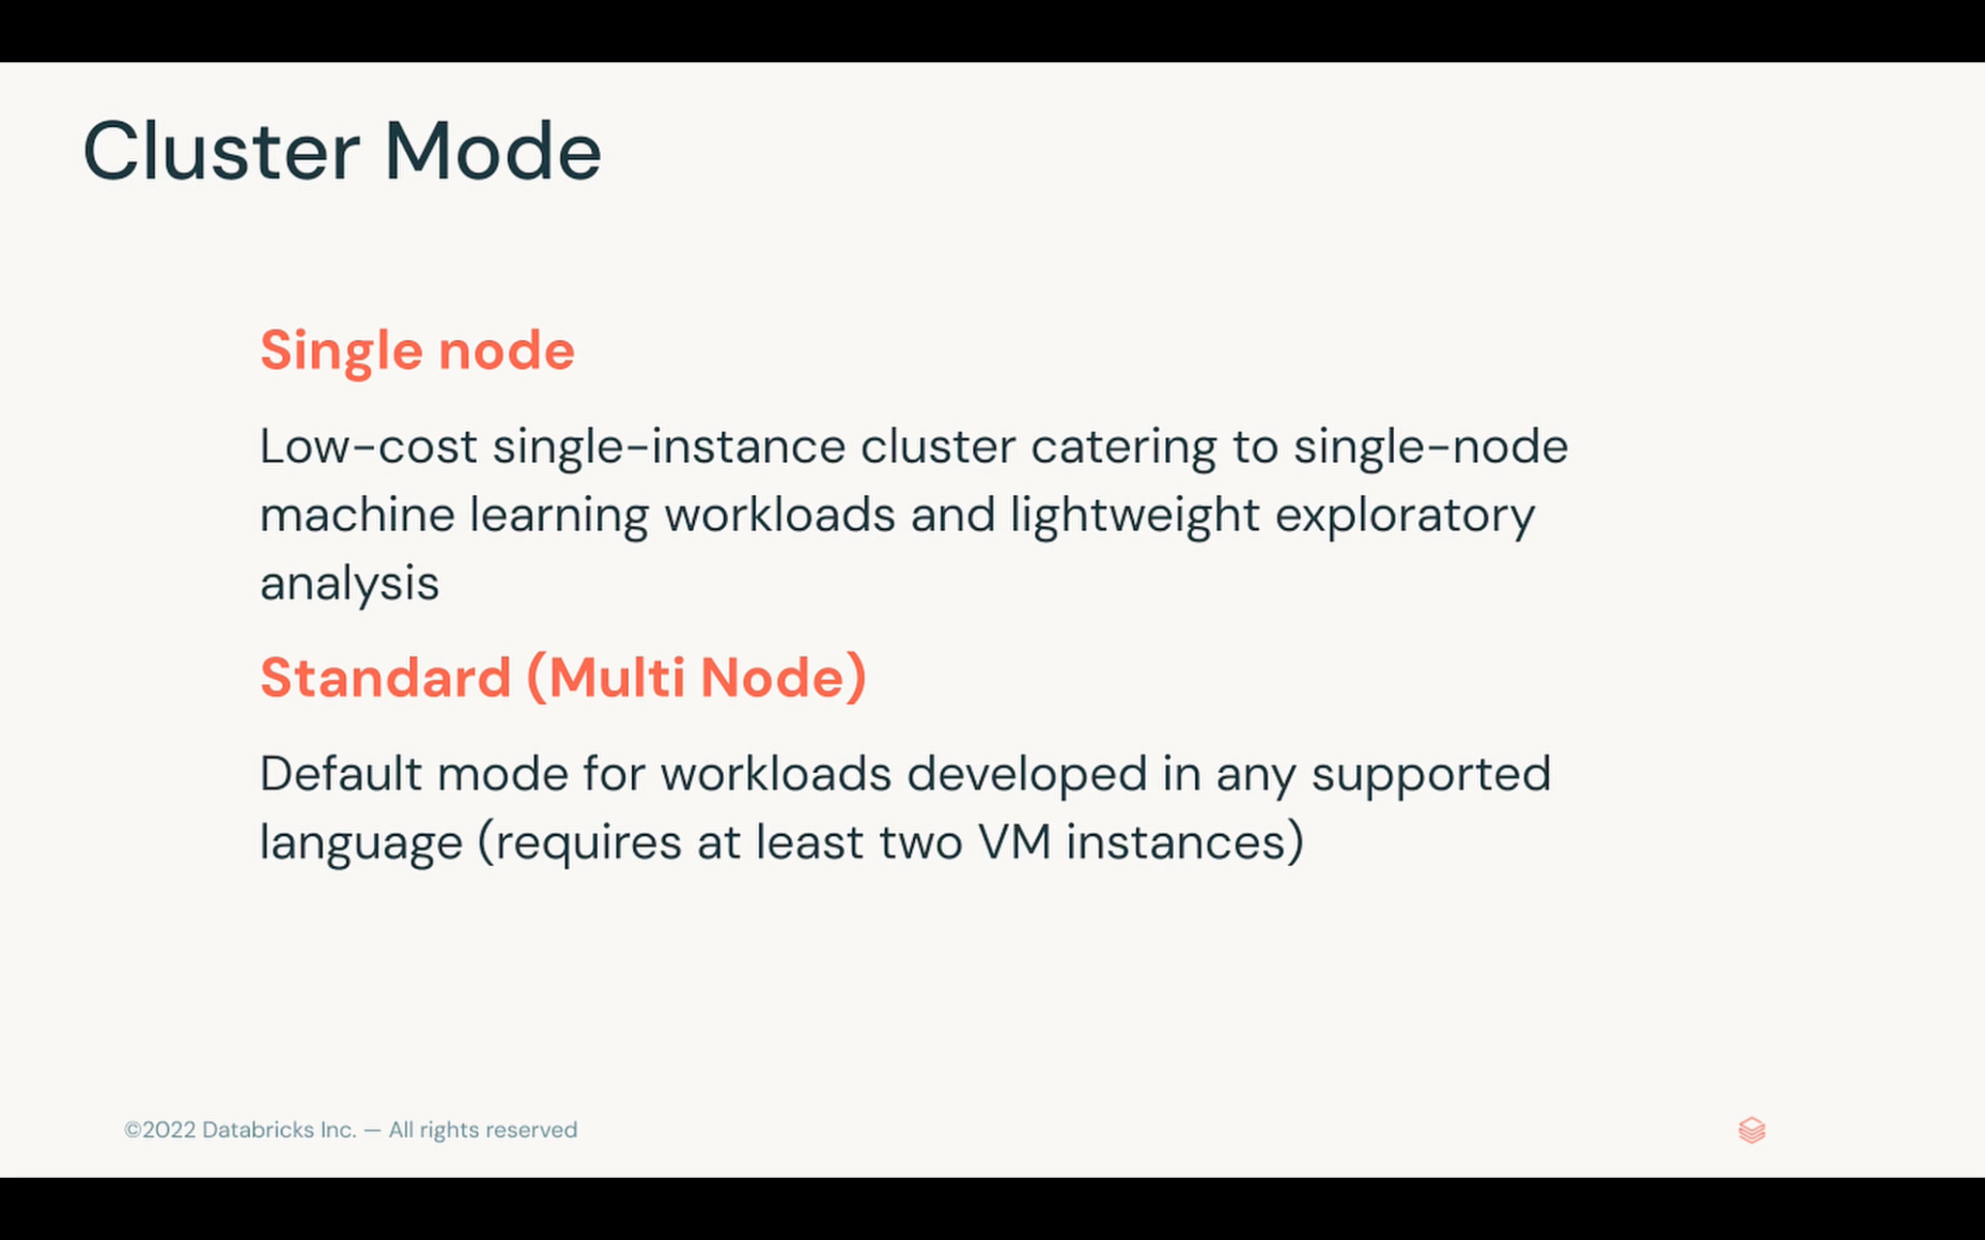

Slide 31
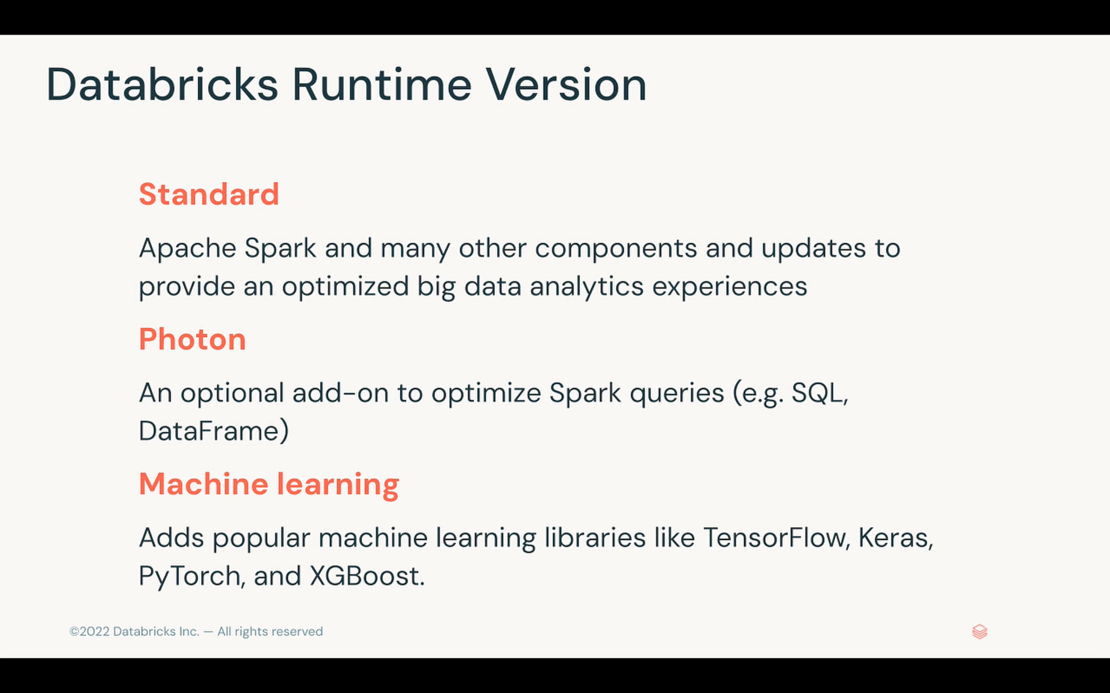

Slide 32
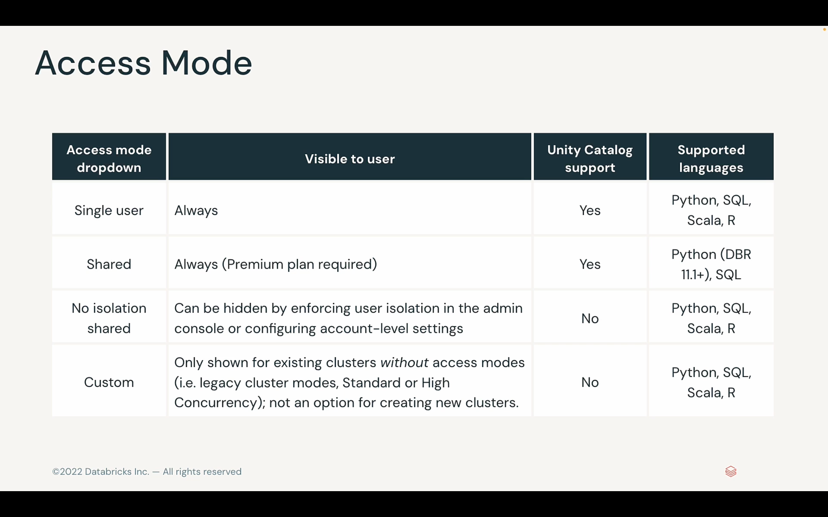

Slide 33
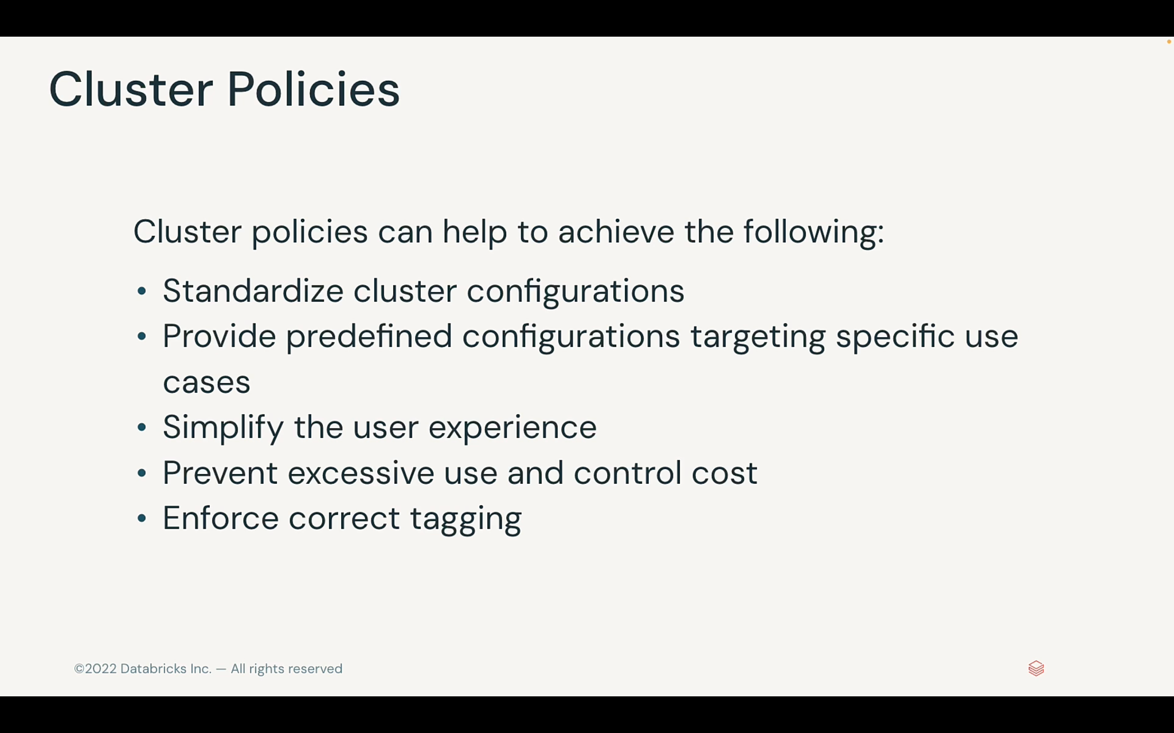

Slide 34
What is DB Notebooks?

Slide 35
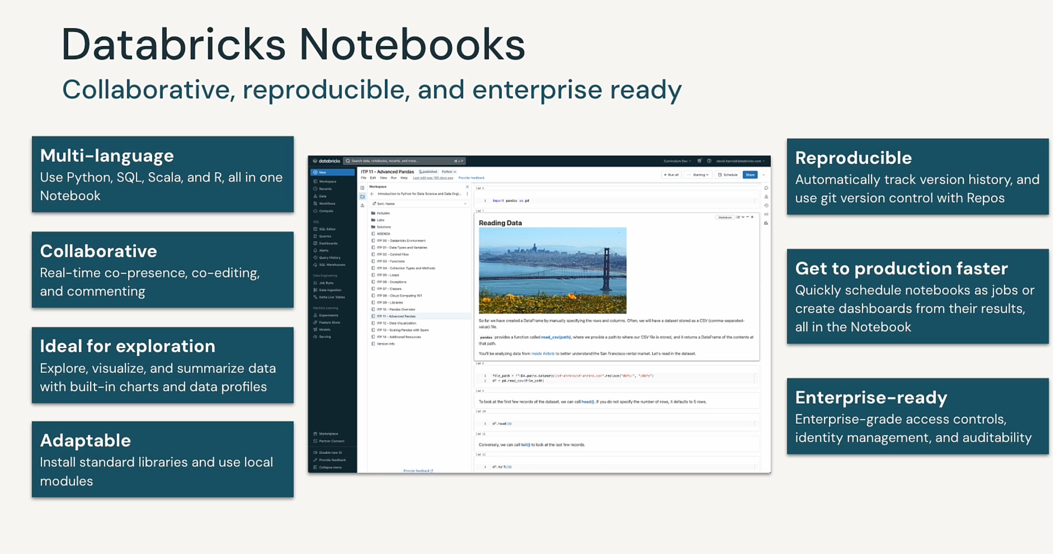

Slide 36
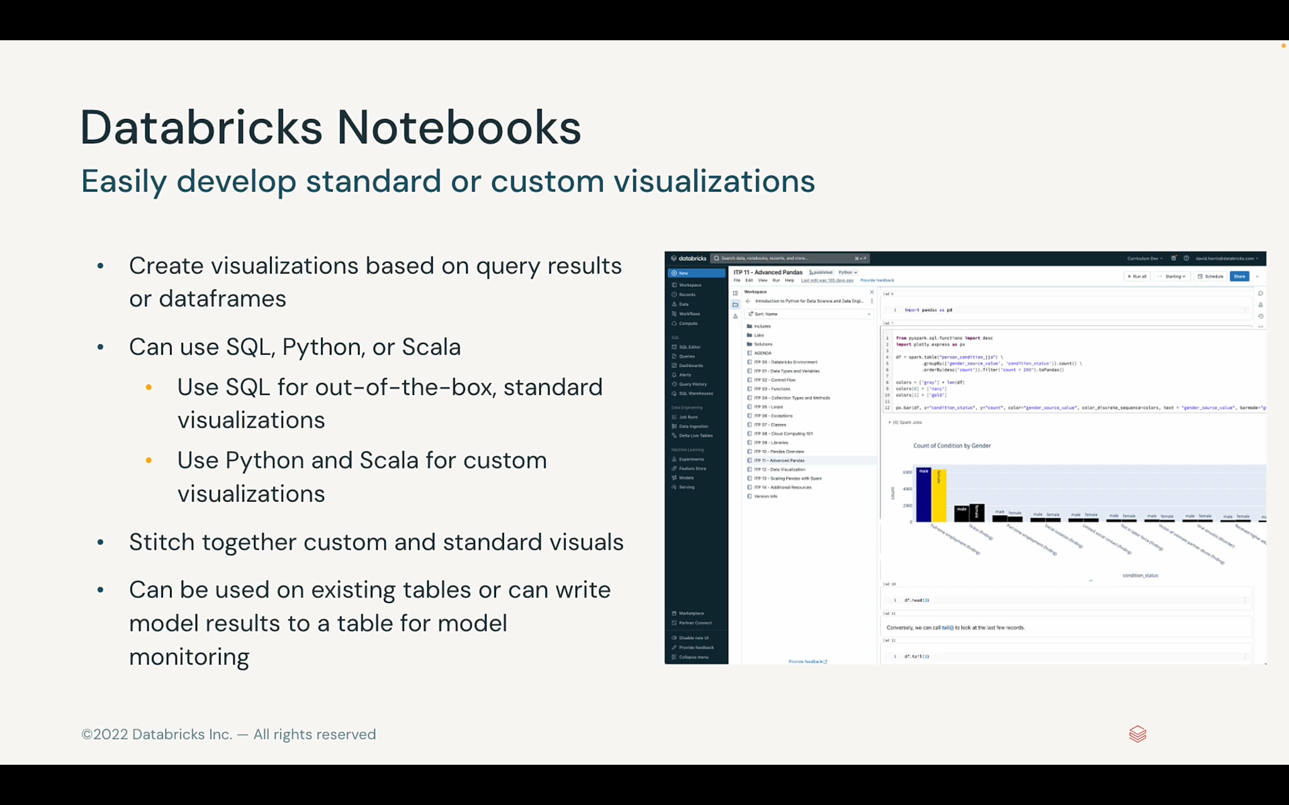

Slide 37
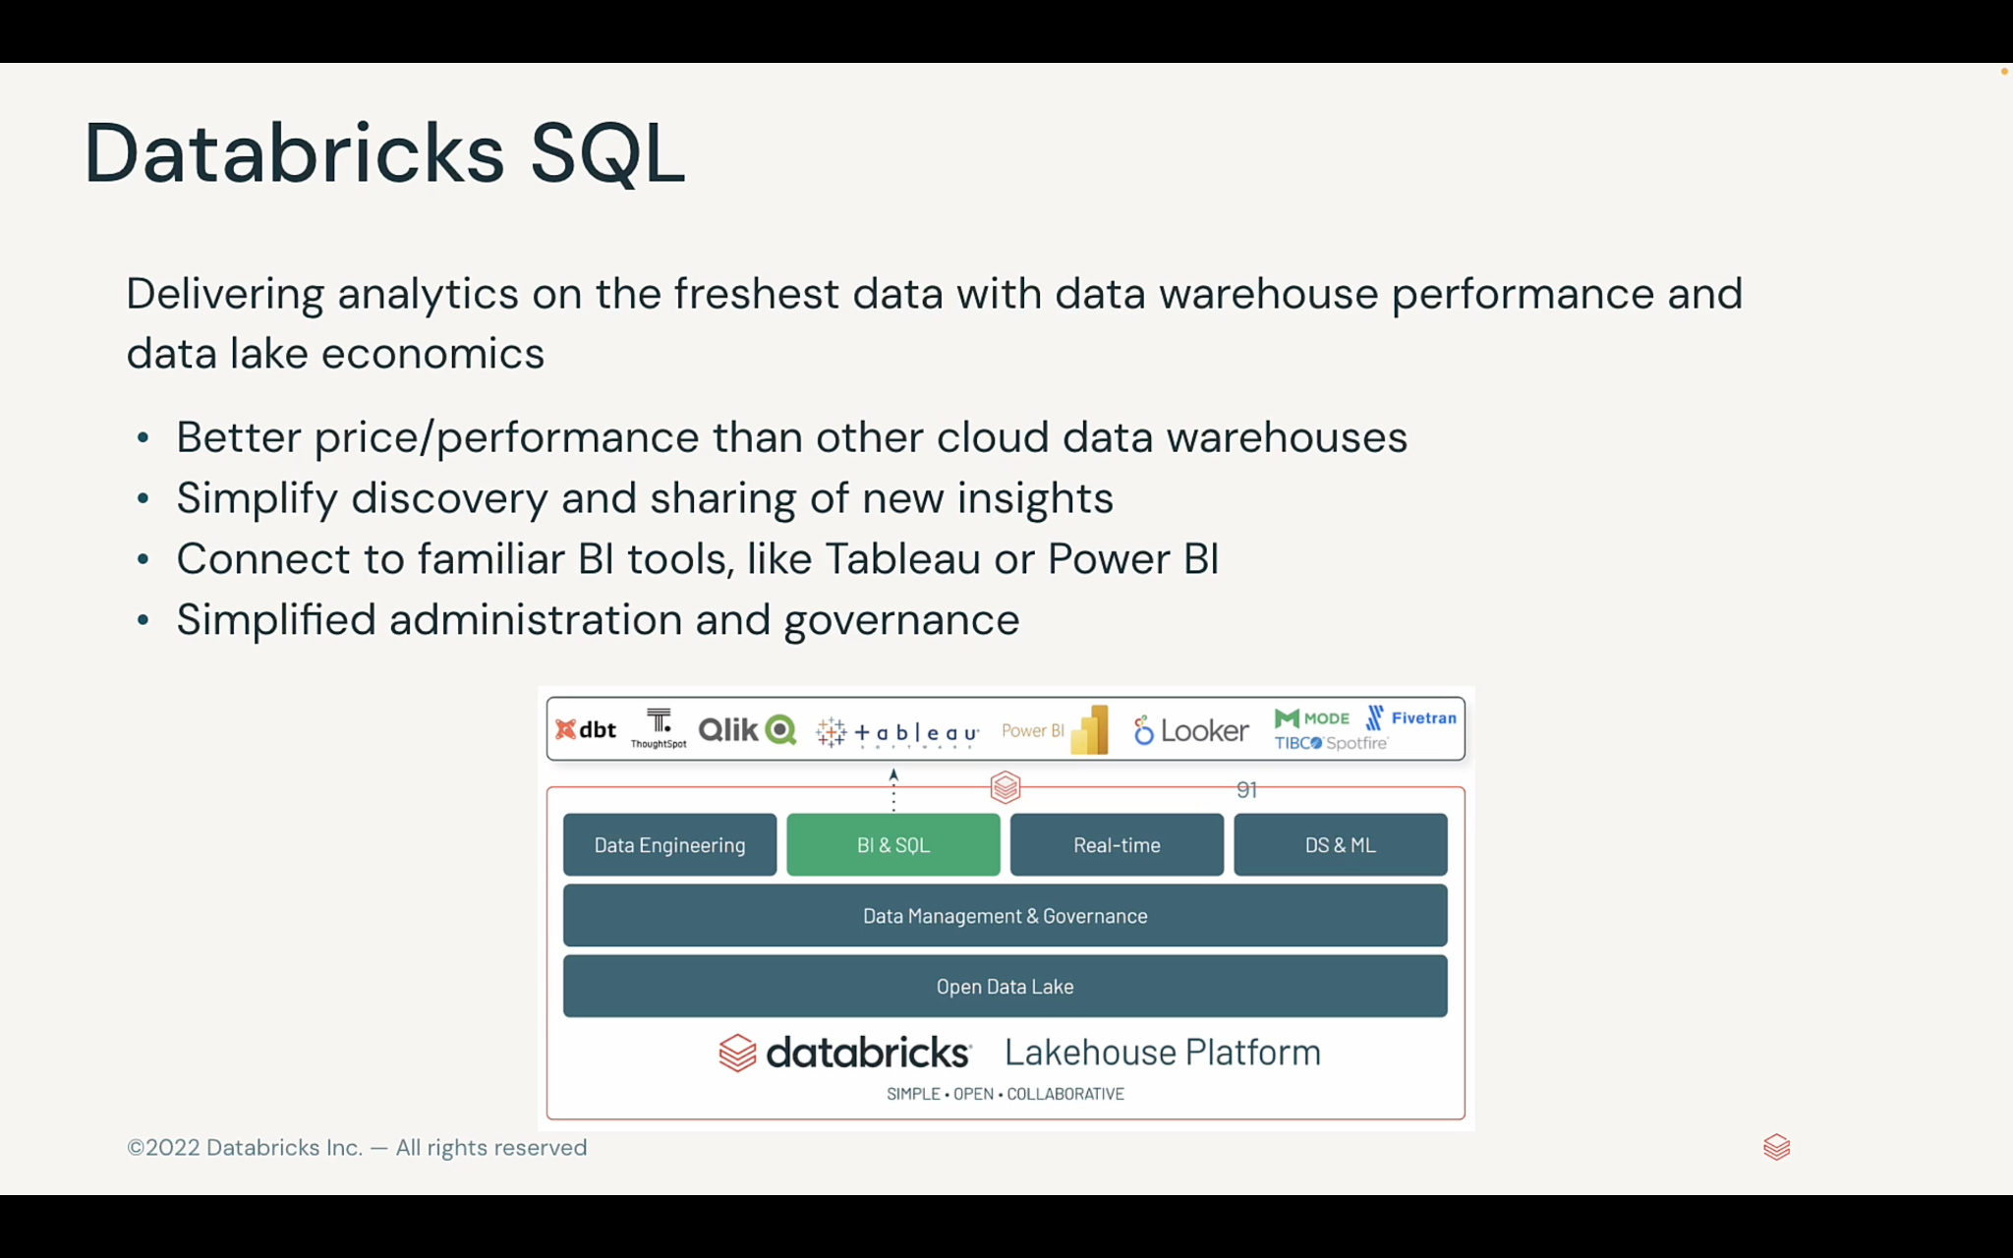

Slide 38
Use Cases
Data exploration and visualization.
Machine learning and AI.
Predictive analytics and forecasting.
Realtime monitoring and alerting.

Slide 39
Case Study
https://github.com/ashishpal2702/AzureDataBricksWorkshop
Delta Lake creation
ML Quick start training
Mlflow end to end

Slide 40
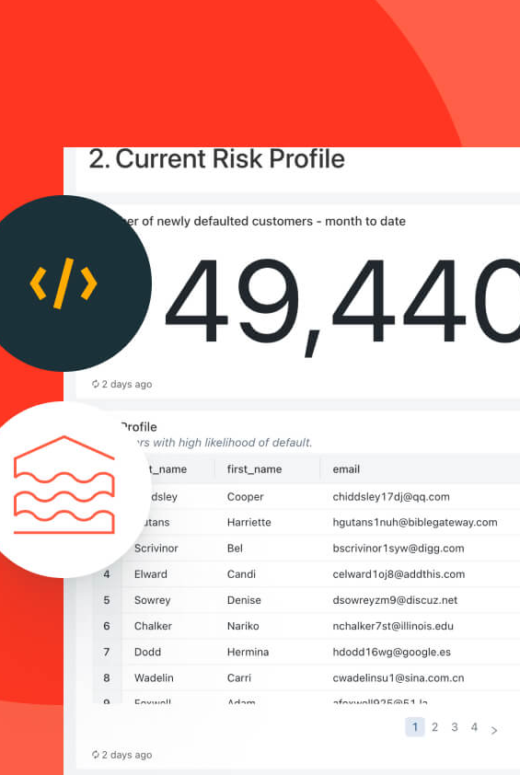
DataBricks Demo
pip install dbdemos
import dbdemos
dbdemos.list_demos()

Slide 41
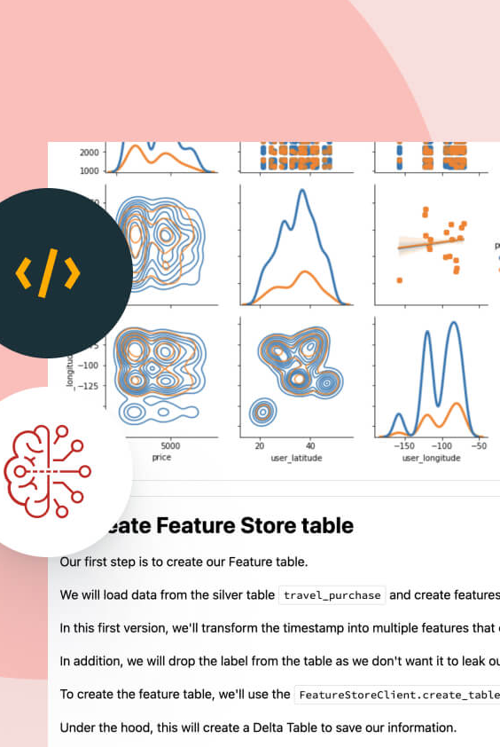
Feature Store
dbdemos.install('feature-store')

Slide 42
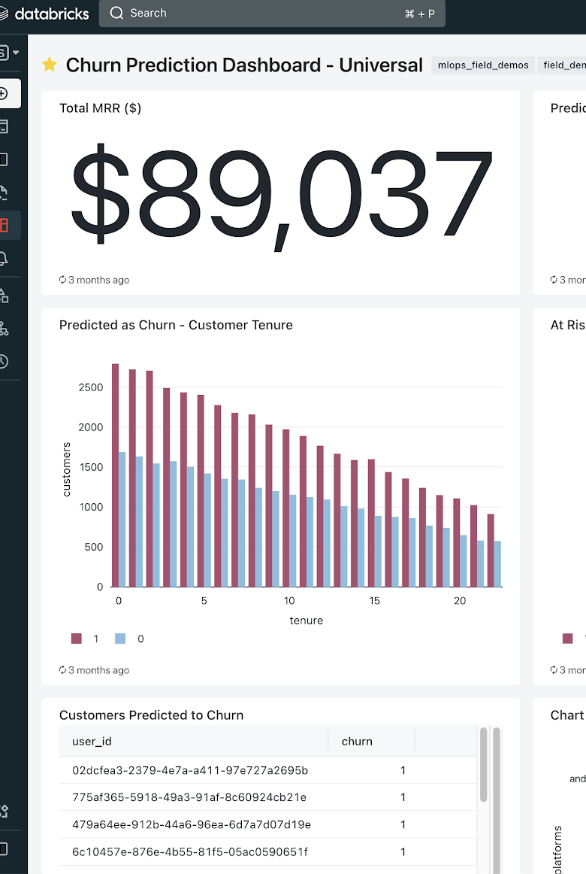
MLOps - End 2 end pipeline
dbdemos.install('mlops-end2end')

Slide 43
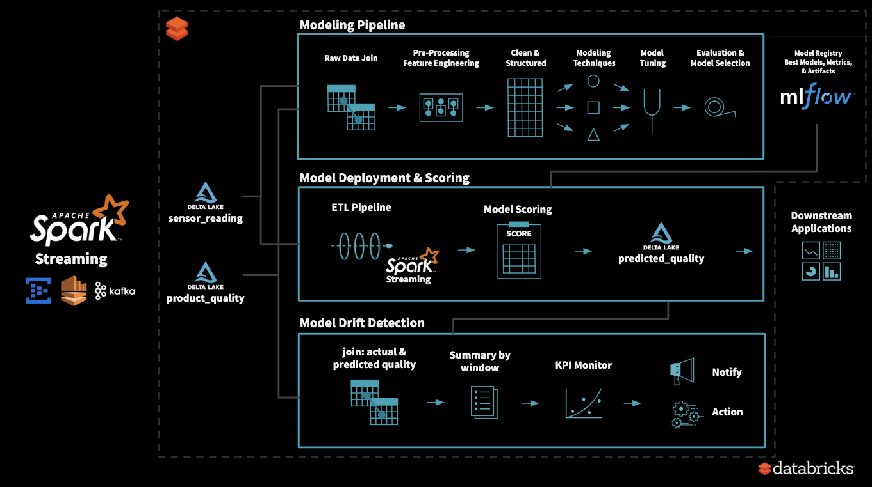
Productionizing Machine Learning: From Deployment to Drift Detection
Blog Code Notebook - https://joelcthomas.github.io/modeldrift/#a_glassware_quality_control.html

Slide 44
Thank you for your time 😊

